Slide 1
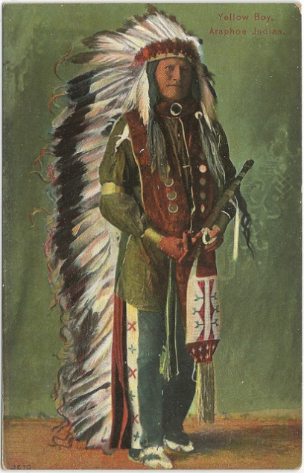
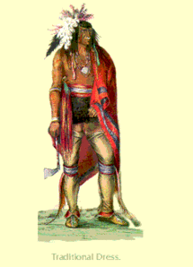
Iroquois and Algonquians
Similarities and Differences
By: Luke Montibello

Slide 2
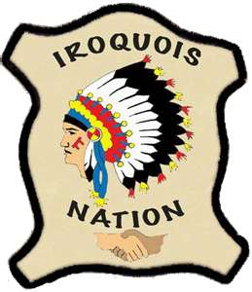
All about the Iroquois
Native Americans
Five peace Wampum Belts
Different ways of marriage
Had clans
Grand Council
Long Houses
Three Sister Crops
Fierce warriors

Slide 3
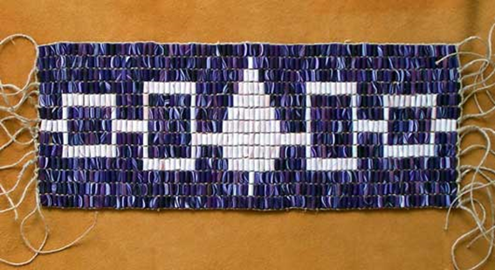
Wampum Belts and Wampum?
A sign of peace
Made of Wampum (not used for currency)
All shown at the grand council
Wampum is money
Wampum is made of carved shells
Wampum is to beads

Slide 4
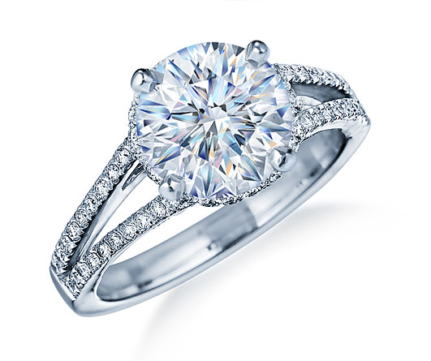
How Iroquoians get married
First the male hunts an animal
Then the male brings the meat to a female
If the male brought back enough edible meat
The female may consider marrying him
Then the female will cook the meat
Then she will put the meat into pottery
They will then share the meal
if they both enjoy the meal they are then married.

Slide 5
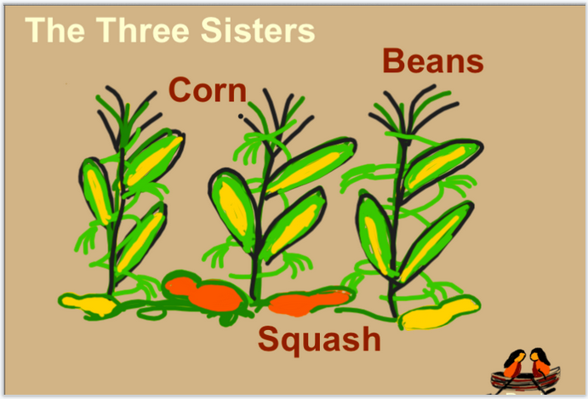
Three Sister Crops
The primary vegetables for the Iroquois are the three sister crops
Corn
Bean
Squash
These are also used for making
Pottery
Ritual Musical Instruments
Food
Tools

Slide 6
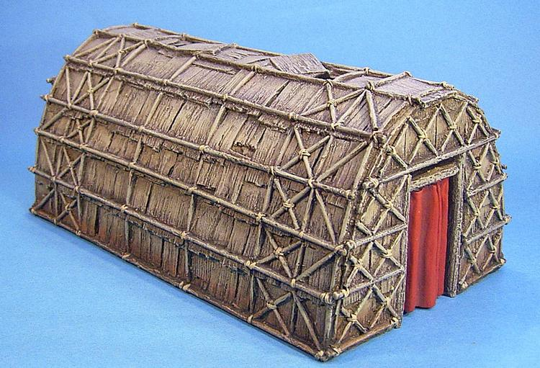
Longhouse
The Iroquois live in the longhouse
Longhouses are
Made of wood
They are colossal
Up to twenty families live together in one longhouse
There is a large hole in roof with a fire under it
The fire is used for
Cooking
warmth
light

Slide 7
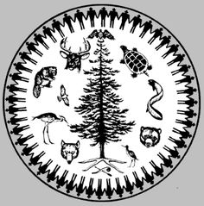
Clans
All the Iroquois are split into tribes
Within five nations
A village within the five nations has several clans in it
A clan is a large family within a village
There are 13 clan types named after animals
There is a clan cup that has all the clans on it.

Slide 8
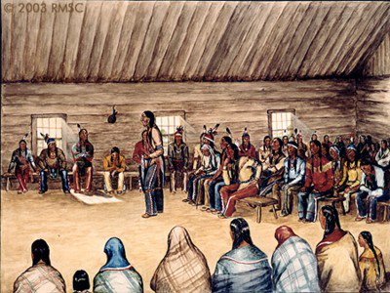
Grand Council
The Grand Council is like our modern day government.
All the leaders of the villages meet together
It is located near modern day Syracuse
This is where they make rules
Settle arguments and make peace or war with the Algonquians.

Slide 9
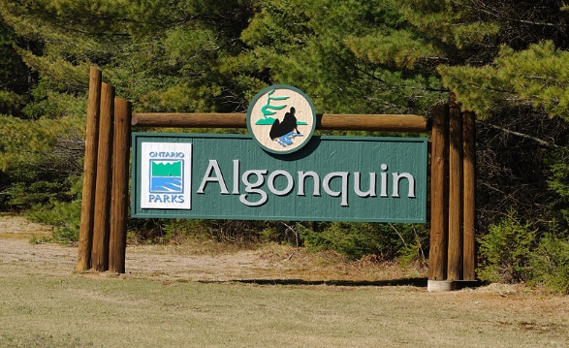
All about the Algonquians
Peaceful
Not connected tribes
Make birch bark canoes
South Western Hudson River
Make dolls out of bees wax
Technologically advance

Slide 10
Peaceful
The Algonquin's did not fight amongst themselves
They tried defended themselves against mighty Iroquois
Simply they lost
They did not steal or attack

Slide 11
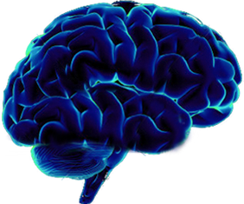
Technologically advance
The Algonquians were a very smart civilization
They made high quality pottery
Great tools
Fast birch bark canoes
Used stones and pottery for Dutch oven cooking

Slide 12
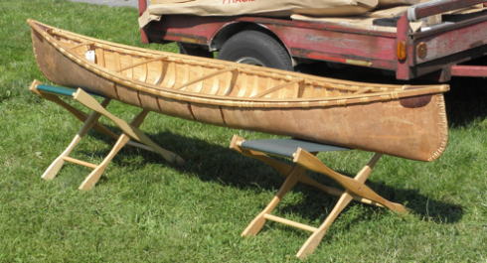
birch bark canoes
Light weight
Super fast
Easy to control
Portable so they can be moved between ponds, lakes and rivers.
Designed with little dents for easier fishing

Slide 13
Not connected tribes
They do not have a big council (government)
The individual tribes were not connected
They had about 200-500 villages within each tribe
Most village were small with only a handful of families
A few were large holding up to 100 families
Each family lived in a small wooden dome
Each village had their own rules

Slide 14
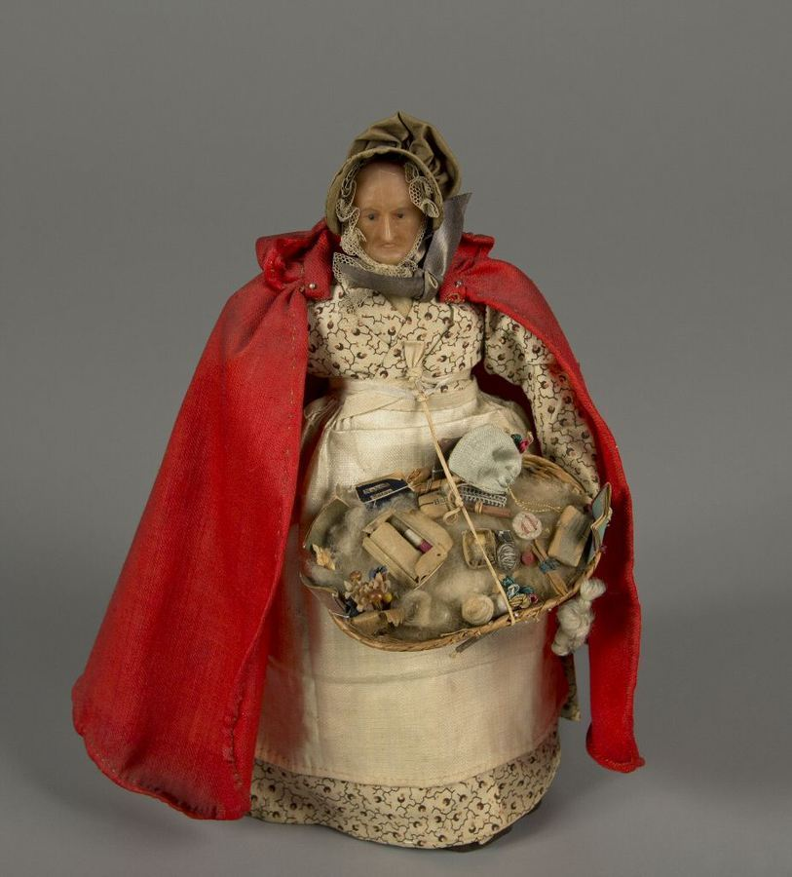
Make dolls out of bees wax
Algonquians made wax dolls for two main reasons
For kids to play with
For sacred rituals
The dolls looked like people
They were dressed with realistic clothing
The dolls were used to tell stories during the rituals

Slide 15
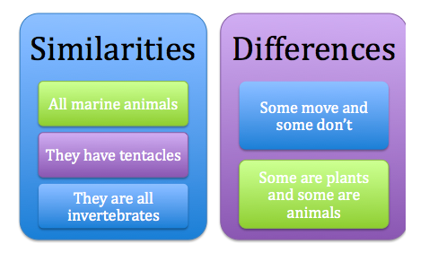
Similarities between Iroquois and Algonquians
Both used canoes
Both had houses
Both fish
Both make pottery
Both had their own language
Both have instruments, singing and dancing in a circle during rituals

Slide 16
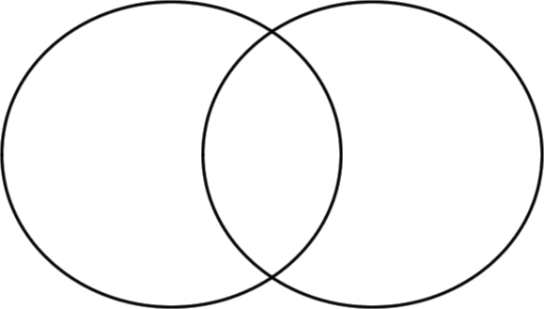
Differences between Iroquois and Algonquians
Algonquians
Iroquois
Fast light Birch Canoes
Lived in small dome houses
Did not like fighting
Have some rituals stories with dolls.
Slow, heavy oak canoes
Lived in large longhouses
War against the Algonquians
Use instrument in rituals

Slide 17
Conclusion
As you can see there are many similarities and differences between the Iroquois and Algonquians

